Slide 1

SACRAMENTORUM SANCTITATIS TUTELA
Brenda prato

Slide 2
What is Sacramentorum Sanctitis Tutela (SST)?
An Apostolic Letter issued ‘Motu Proprio’
It was issued by John Paul II in April 30, 2001
By SST, the Roman Pontiff promulgated norms on more grave delicts reserved to the CDF.
It mentions several other documents including:
The Constitution Sacramentum Poenitentiae of Pope Benedict XIV (1741)
The Instruction Crimen Sollicitationis by Pope Paul Vi (1962)
The Constitution Regimini Ecclesiae Universae by Pope Paul VI (1967)
The Constitution Pastor Bonus by Pope John Paul II (1988)
Agendi Ratio in Doctrinarum Examine by the CDF, under Prefect Ratzinger (1997)
it promulgated the Norms concerning the more grave delicts reserved to the CDF (Substantive Norms and Procedural Norms) which were then revised in 2010.
This is why we will be discussing these norms in these presentation.

Slide 3
Norms concerning the more grave delicts reserved to the CDF
It is divided into two parts: Part One & Part Two
Part One: Substantive Norms contains Art. 1 – Art. 7.
Part Two: Procedural Norms contains:
Title 1: The Constitution and Competence of the Tribunal (Art. 8 – Art. 20)
Title II: The Procedure to be followed in the Judicial Trial (Art. 21 – Art. 31)

Slide 4
Part One: Substantive Norms Art. 1: Competence of the CDF
This document emphasizes the role and competence of the CDF. It states that the CDF,
“… judges delicts against the faith, as well as the more grave delicts committed against morals and in the celebration of the sacraments and, whenever necessary, proceeds to declare or impose canonical sanctions according to the norm of both common and proper law,..” (Art 1 §1)
“may judge Cardinals, Patriarchs, Legates of the Apostolic See, Bishops as well as other physical persons mentioned in can. 1405 §3 of the Code of Canon Law...” (Art 1 §2)
“The Congregation for the Doctrine of the Faith judges the reserved delicts mentioned in § 1 according to the following norms.” (Art 1 § 3)

Slide 5
Part One: Substantive Norms Art. 2: Heresy, Apostasy and Schism
Heresy apostasy and schism are the three delicts against the faith referred to in Art. 1 §1.
It emphasizes that these three delicts incur latae sententiae excommunications.
In case of a cleric, the penalties mentioned in Can. 1336 apply:
“1/ a prohibition or an order concerning residence in a certain place or territory;
2/ privation of a power, office, function, right, privilege, faculty, favor, title, or insignia, even merely honorary;
3/ a prohibition against exercising those things listed under n. 2, or a prohibition against exercising them in a certain place or outside a certain place; these prohibitions are never under pain of nullity;
4/ a penal transfer to another office;
5/ dismissal from the clerical state.”
It is up to the Ordinary (in the Latin Church) or the Hierarch (in the Oriental Church) to decide whether:
to undertake a judicial trial in the first instance
Or to issue an extrajudicial decree
“… with due regard for the right of appeal or of recourse to the CDF.” (Art 2 §2)

Slide 6
Part One: Substantive Norms Art. 3: More Grave Delicts: Eucharist
Grave delicts on the Eucharist are reserved to the CDF.
1° the taking or retaining for a sacrilegious purpose or the throwing away of the consecrated species, as per Can. 1367.
2° attempting the liturgical action of the Eucharistic Sacrifice spoken of in can. 1378 § 2, n. 1 (though not promoted to the sacerdotal order).
3° the simulation of the same, spoken of in can. 1379.
4° the concelebration of the Eucharistic Sacrifice prohibited in can. 908, spoken of in can. 1365, with ministers of ecclesial communities which do not have apostolic succession and do not acknowledge the sacramental dignity of priestly ordination.
The CDF also has competence to judge delicts consisting in consecration for a sacrilegious purpose of one matter without the other or even of both (with/without/outside/inside the eucharistic celebration). This is to be punished according to its gravity, not excluding dismissal or deposition. (Art 3 §2).

Slide 7
Part One: Substantive Norms Art. 4 More Grave Delicts: Penance
Grave delicts on Penance are reserved to the CDF.
1° the absolution of an accomplice in a sin against the sixth commandment of the Decalogue, mentioned in can. 1378 § 1.
2° attempted sacramental absolution or the prohibited hearing of confession, mentioned in can. 1378 § 2, 2°;
3° simulated sacramental absolution, mentioned in can. 1379;
4° the solicitation to a sin against the sixth commandment of the Decalogue in the act, on the occasion, or under the pretext of confession, as mentioned in can. 1387, if it is directed to sinning with the confessor himself;
5° the direct and indirect violation of the sacramental seal, mentioned in can. 1388 § 1;
The 5th point is taken very seriously. It cannot be recorded by any technical means nor can it be shared through any communications media of whatever is said during a sacramental confession irrelevant its truth or falsehood by both confessor and penitent. This is to be punished according to its gravity, not excluding dismissal or deposition. (Art 4 §2).

Slide 8
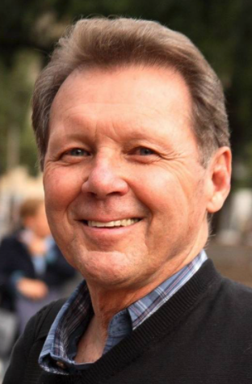
Part One: Substantive Norms Art. 5 More Grave Delicts: Woman Ordination
Ordination of a woman is considered as a grave delict and it is also reserved to the CDF.
Whoever attempts the ordination as well as the woman that attempts to receive the ordination incurs a latae sententiae excommunication.
If the guilty party is a cleric, he may be punished by dismissal or deposition.
Ex-priest Roy Bourgeois was laicized and excommunicated for ordaining a woman.

Slide 9
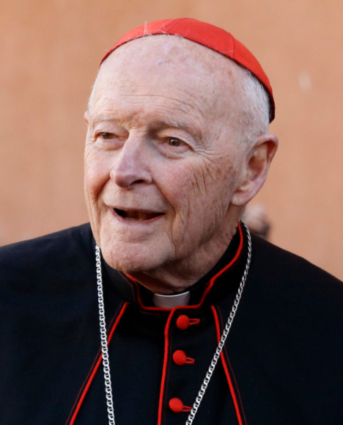
Part One: Substantive Norms Art. 6 More Grave Delicts: Morals
1° the delict against the sixth commandment of the Decalogue committed by a cleric with a minor below the age of eighteen years; in this number, a person who habitually has the imperfect use of reason is to be considered equivalent to a minor.
2° the acquisition, possession, or distribution by a cleric of pornographic images of minors under the age of fourteen, for purposes of sexual gratification, by whatever means or using whatever technology;
Ex-Cardinal McCarrick was laicized in 2019 for being found guilty of sexual misconduct and abuse with of adults and minors.

Slide 10
Part One: Substantive Norms Art. 7 Prescription
Any criminal action that includes any of the delicts reserved to the CDF has a prescription of 20 years. However, the CDF has the right to derogate from the prescription in individual cases.
As per Can. 1362, action concerning delicts mentioned below has a prescription of 5 years:
Can. 1394 (a cleric that attempts marriage),
Can. 1395 (a cleric who lives in concubinage and persists in committing scandal due to the 6th commandment),
Can. 1397 (a person who commits a homicide or who kidnaps, detains, mutilates, or gravely wounds a person by force or fraud) and
Can. 1398 (a person who procures a completed abortion).
However, “a cleric who commits the delicts mentioned above in § 1 is to be punished according to the gravity of his crime, not excluding dismissal or deposition.” (Art. 7 §2)

Slide 11

Part Two: Procedural Norms (Title I) Art. 8 The Competence of the CDF
Art. 8 states that the CDF is:
The Supreme Apostolic Tribunal for both the Latin and the Eastern Catholic Churches for those delicts mentioned in the previous articles.
Other delicts can be judged by the CDF where a defendant is accused by the Promoter of Justice by reason of connection of person and complicity.
The sentences executed by the CDF do not need to be approved by the Supreme Pontiff provided that they were under the competence of the CDF.

Slide 12
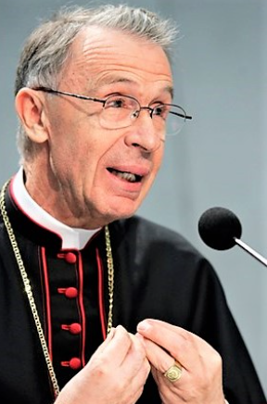
Part Two: Procedural Norms (Title I) Art. 9 The Prefect & Members of the CDF
The members of the CDF are ipso facto judges of this Supreme Tribunal.
The Prefect of the CDF presides as first among equals in the college of the Members.
If the Prefect Office is vacant or if the Prefect himself is impeded, the Secretary of the CDF is to carry our his duties.
Additional stable or deputed judges are the responsibility of the prefect to nominate.
Cardinal Luis Ladaria Ferrer is the current Prefect of the CDF

Slide 13
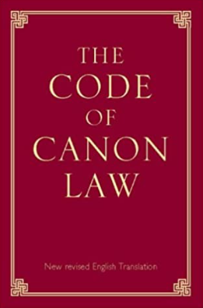
Part Two: Procedural Norms (Title I) Art. 10 Qualifications of the CDF Members
It is necessary that such appointed judge:
be priests,
of mature age,
possessing a doctorate in canon law
outstanding in good morals,
prudence and expertise in the law.
Such priests may at the same time exercise a judicial or consultative function before another Dicastery of the Roman Curia.

Slide 14
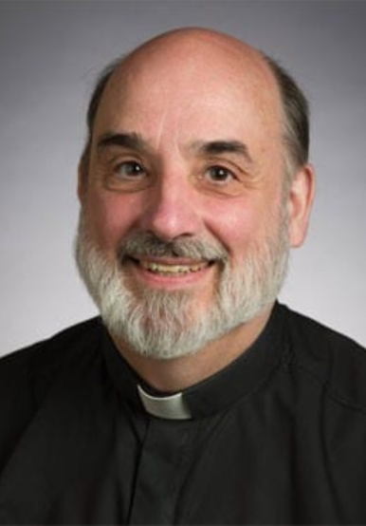
Part Two: Procedural Norms (Title I) Art. 11 The Promoter of Justice
To present and sustain an accusation a Promoter of Justice is to be appointed, who:
is to be a priest,
possessing a doctorate in canon law,
outstanding in good morals,
prudence, and
expertise in the law.
He is to carry out his office in all grades of judgment.
Fr Robert J. Geisinger, SJ is the current CDF Promoter of Justice

Slide 15
Part Two: Procedural Norms (Title I) Art. 12 – Art. 15: Roles within the CDF
Art. 12 “For the functions of Notary and Chancellor, priests are appointed, whether or not they are officials of this Congregation.”
Art. 13 “The role of Advocate or Procurator is carried out by a priest possessing a doctorate in canon law. He is to be approved by the presiding judge of the college.”
Art. 14 ”Indeed, in the other tribunals dealing with cases under these norms, only priests can validly carry out the functions of Judge, Promotor of Justice, Notary, and Patron [Procurator and Advocate].”
Art 15 “With regard to the provisions of can. 1421 of the Code of Canon Law, the Congregation for the Doctrine of the Faith may dispense from the requirements of the priesthood and of a doctorate in Canon Law.”

Slide 16
Part Two: Procedural Norms (Title I) Art. 16: Instruction to Ordinary/Hierarch
Notitiam or Allegation
Preliminary Investigation (Can. 1717)
Whenever the Ordinary or Hierarch receives a report of a more grave delict, which has at least the semblance of truth, once the preliminary investigation has been completed, he is to communicate the matter to the Congregation for the Doctrine of the Faith which, unless it calls the case to itself due to particular circumstances, will direct the Ordinary or Hierarch how to proceed further, with due regard, however, for the right to appeal, if the case warrants, against a sentence of the first instance only to the Supreme Tribunal of this same Congregation.
Ordinary/Hierarch
Graviora Delicta?
Semblance of Truth?
Inform CDF!

Slide 17
Part Two: Procedural Norms (Title I) Art. 17: No Preliminary Investigation?
Notitiam or Allegation
Preliminary Investigation (Can. 1717)
If a case is referred directly to the Congregation without a preliminary investigation having been undertaken, the steps preliminary to the process, which fall by common law to the Ordinary or Hierarch, may be carried out by the Congregation itself.
Ordinary/Hierarch
Graviora Delicta?
Semblance of Truth?
CDF will carry out the Preliminary Investigation itself!
Inform CDF!

Slide 18
Part Two: Procedural Norms (Title I) Art. 18: Sanation w.r.t. Right of Defense
With full respect for the right of defense, the Congregation for the Doctrine of the Faith may sanate acts in cases lawfully presented to it if merely procedural laws have been violated by lower Tribunals acting by mandate of the same Congregation or according to art. 16.
Part Two: Procedural Norms (Title I) Art. 20: CDF as Second Instance
The Supreme Tribunal of the Congregation for the Doctrine of the Faith judges in second instance:
1° cases adjudicated in first instance by lower tribunals;
2° cases decided by this same Supreme Apostolic Tribunal in first instance.

Slide 19
Part Two: Procedural Norms (Title I) Art. 19: No Preliminary Investigation?
With due regard for the right of the Ordinary to impose from the outset of the preliminary investigation those measures which are established in can. 1722 of the Code of Canon Law, the respective presiding judge may, at the request of the Promoter of Justice, exercise the same power under the same conditions determined in the canons themselves.
What does Can. 1722 say?
“To prevent scandals, to protect the freedom of witnesses, and to guard the course of justice, the ordinary, after having heard the promoter of justice and cited the accused, at any stage of the process can exclude the accused from the sacred ministry or from some office and ecclesiastical function, can impose or forbid residence in some place or territory, or even can prohibit public participation in the Most Holy Eucharist. Once the cause ceases, all these measures must be revoked; they also end by the law itself when the penal process ceases.”

Slide 20
Part Two: Procedural Norms (Title II) Art. 21: No Preliminary Investigation?
All grave delicts reserved to the CDF are to be tried in a judicial process.
But the CDF may:
1° decide, in individual cases, ex officio or when requested by the Ordinary or Hierarch, to proceed by extrajudicial decree, as provided in can. 1720 of the Code of Canon Law. However, perpetual expiatory penalties may only be imposed by mandate of the Congregation for the Doctrine of the Faith.
2° present the most grave cases to the decision of the Roman Pontiff with regard to dismissal from the clerical state or deposition, together with dispensation from the law of celibacy, when it is manifestly evident that the delict was committed and after having given the guilty party the possibility of defending himself.

Slide 21
Part Two: Procedural Norms (Title II) Art. 22: The turnus of the CDF
The Prefect is to constitute a turnus of three or five judges to try the case.
Part Two: Procedural Norms (Title II) Art. 23: Appellate Stage: New Accusation
If in the appellate stage the Promotor of Justice brings forward a specifically different accusation, this Supreme Tribunal can admit it and judge it as if at first instance.

Slide 22
Part Two: Procedural Norms (Title II) Art. 24: GDPR, Credibility & Sacr. Seal
§ 1. In cases concerning the delicts mentioned of in art. 4 §1, the Tribunal cannot indicate the name of the accuser to either the accused or his patron unless the accuser has expressly consented.
§ 2. This same Tribunal must consider the particular importance of the question concerning the credibility of the accuser.
§ 3. Nevertheless, it must always be observed that any danger of violating the sacramental seal be altogether avoided.
Part Two: Procedural Norms (Title II) Art. 25: Incidental Cases: Expeditissime!
If an incidental question arises, the college is to decide the matter by decree most expeditiously as per Can. 1629 n. 5: “There is no appeal from a sentence or a decree in a case where the law requires the matter to be decided as promptly as possible (expeditissime).”

Slide 23
Part Two: Procedural Norms (Title II) Art. 26: The Appeal
§ 1. With due regard for the right to appeal to this Supreme Tribunal, once an instance has been finished in any manner before another tribunal, all of the acts of the case are to be transmitted ex officio to the Congregation for the Doctrine of the Faith as soon as possible.
§ 2 The right of the Promotor of Justice of the Congregation to challenge a sentence runs from the day on which the sentence of first instance is made known to this same Promoter.
Art. 27: The Recourse
Recourse may be had against singular administrative acts which have been decreed or approved by the Congregation for the Doctrine of the Faith in cases of reserved delicts. Such recourse must be presented within the preemptory period of sixty canonical days to the Ordinary Session of the Congregation (the Feria IV) which will judge on the merits of the case and the lawfulness of the Decree. Any further recourse as mentioned in art. 123 of the Apostolic Constitution Pastor bonus is excluded.

Slide 24
Part Two: Procedural Norms (Title II) Art. 28: Res Iudicata
A res iudicata occurs:
1° if a sentence has been rendered in second instance;
2° if an appeal against a sentence has not been proposed within a month;
3° if, in the appellate grade, the instance is abated or is renounced;
4° if the sentence has been rendered in accord with the norm of art.20.
Art. 29: Judicial Expenses
§ 1. Judicial expenses are to be paid as the sentence has determined.
§ 2. If the defendant is not able to pay the expenses, they are to be paid by the Ordinary or Hierarch of the case.

Slide 25
Part Two: Procedural Norms (Title II) Art. 30: Pontifical Secret on Expenses
§ 1. Cases of this nature (where the Ordinary is to pay if defendant cannot) are subject to the pontifical secret.
§ 2. Whoever has violated the secret, whether deliberately (ex dolo) or through grave negligence, and has caused some harm to the accused or to the witnesses, is to be punished with an appropriate penalty by the higher turnus at the insistence of the injured party or even ex officio.
Art. 31: Insistence on Application
In these cases, together with the prescripts of these norms, by which all Tribunals of the Latin Church and Eastern Catholic Churches are bound, the canons concerning delicts and penalties as well as the canons concerning the penal process of each Code also must be applied.

Slide 26
Conclusion:
With SST (2001)’s promulgation of these norms, Pope Benedict XVI revised these norms in 2010 and these are this is what was discussed in this presentation.
It focuses on those delicta graviora that are reserved to the CDF and how the respective procedure is to proceed.
The preliminary investigation is always to be carried out. We have seen that if it is not carried out by the Ordinary/Hierarch, it will be carried out by the CDF.
The CDF may investigate a case and then forward to the ordinary with instructions.
These graviora delicta include those delicts against the faith (heresy, apostacy and schism), Eucharist, Penance, Ordination of Women, and morals (against the 6th Commandment).
The competence of the CDF is redefined in SST.

