Slide 1
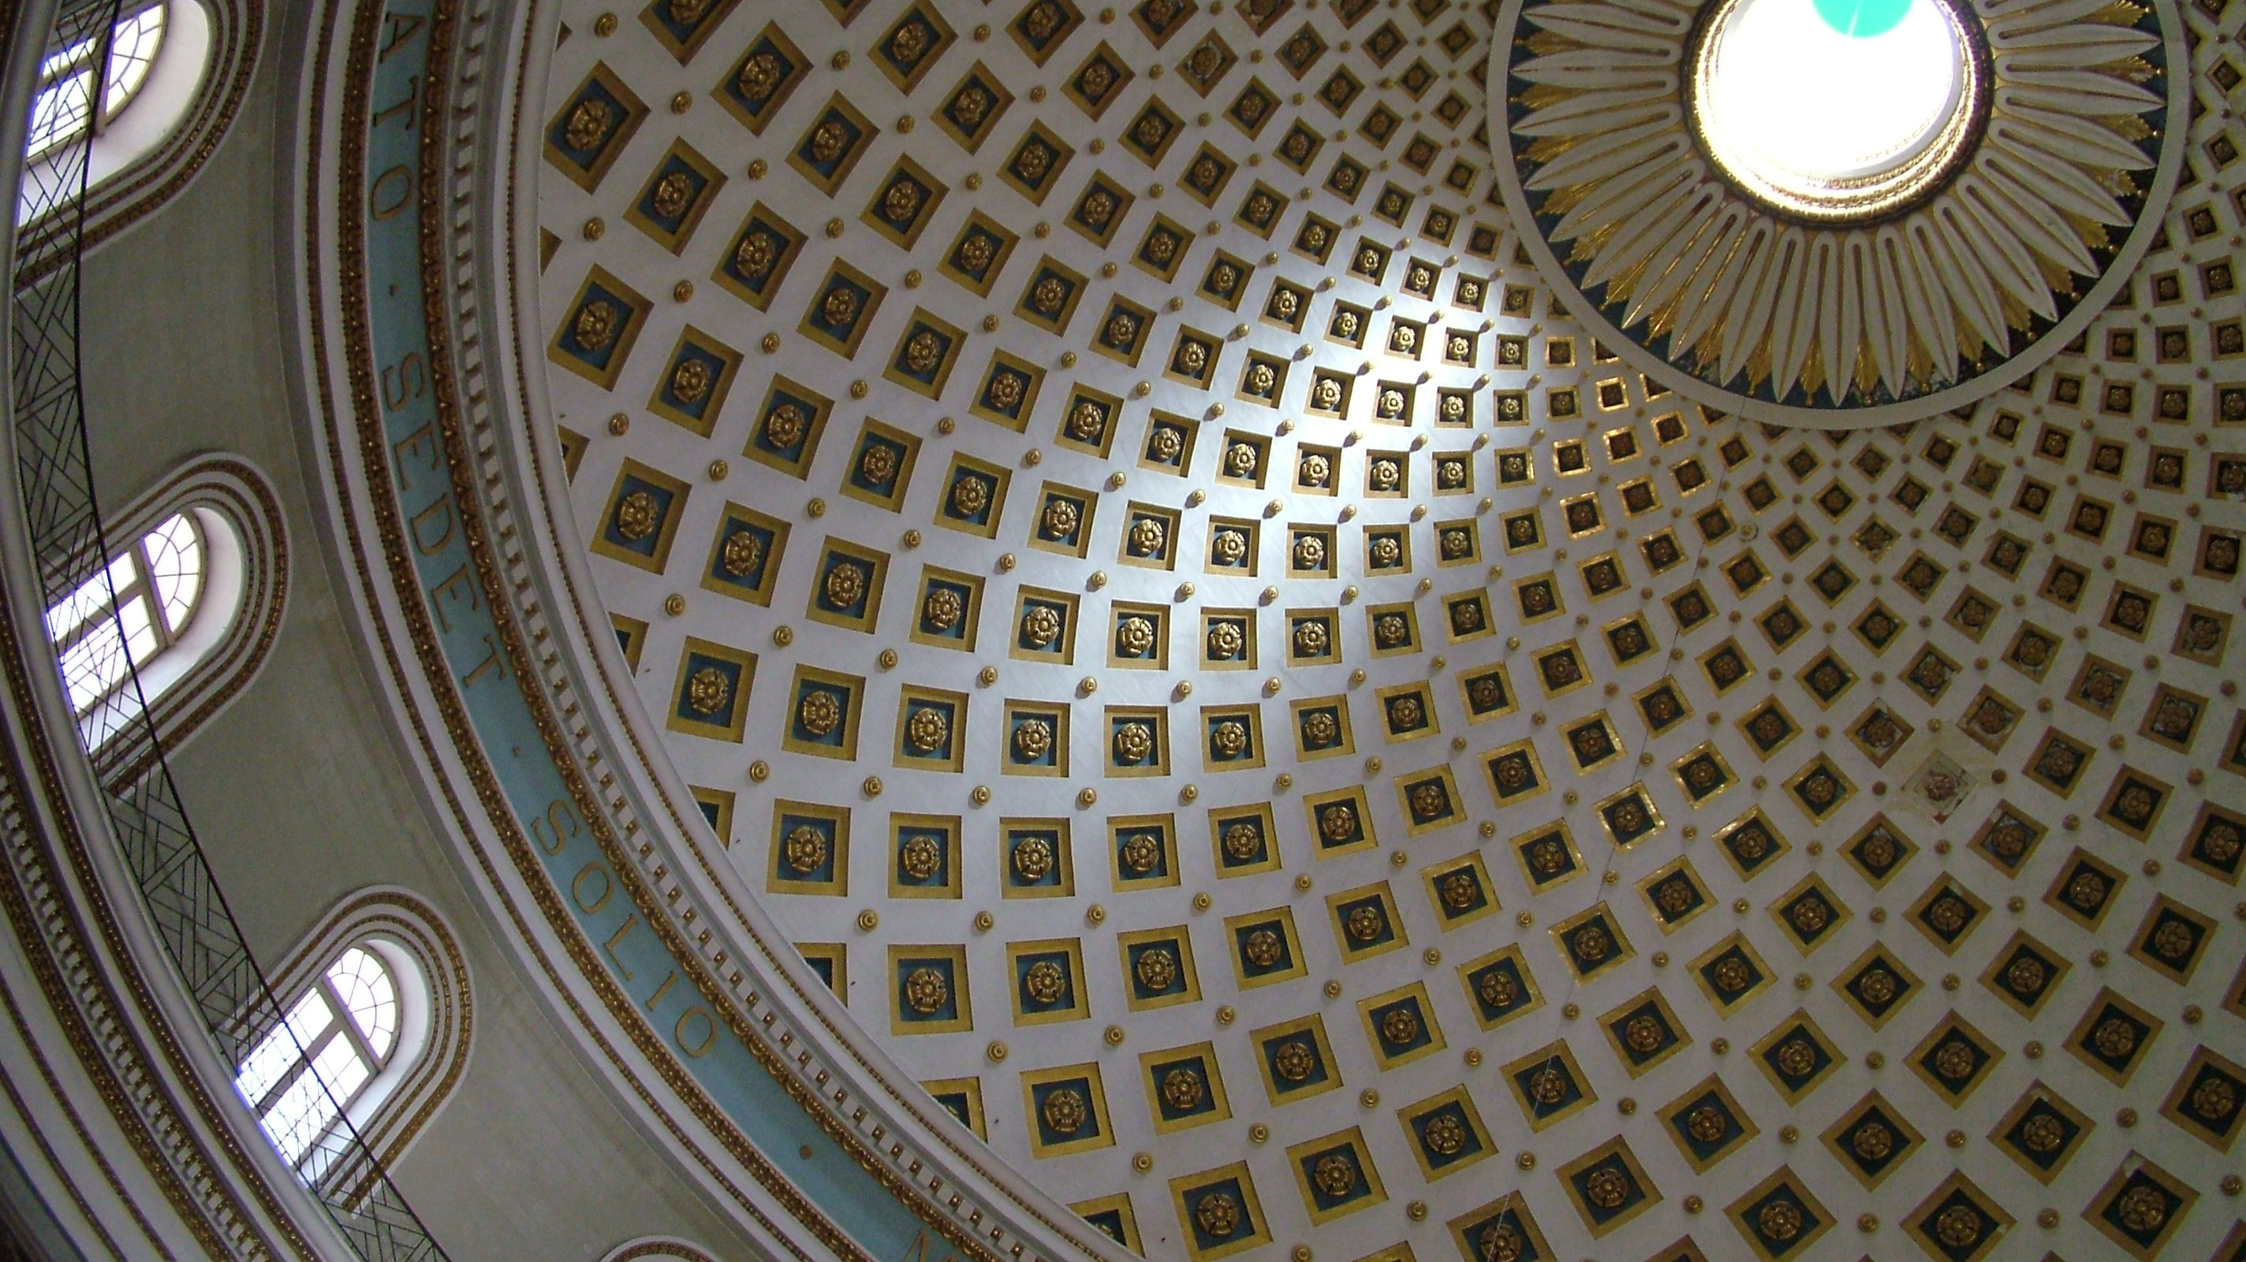
Sacred Places in Canon Law
CIC/1983:
Book IV Part III: cc. 1205 – 1243
CCEO/1990:
Title XVI: Chp V: cc. 868 - 873
Brenda Prato JCL

Slide 2
Definition (c. 1205)
"Sacred places are those which are designated for divine worship or for the burial of the faithful by a dedication or a blessing which the liturgical books prescribe for this purpose."
Notes:
Check Chapter V (288 - 318): https://www.vatican.va/roman_curia/congregations/ccdds/documents/rc_con_ccdds_doc_20030317_ordinamento-messale_en.html

Slide 3
So, a sacred place….
… has a sole purpose: to serve the faithful for divine worship (or burial);
… must follow the liturgical books which are updated from time to time;
… is either 'dedicated' (by the diocesan bishop) or 'blessed' (by the ordinary).

Slide 4
Proof?
Once a sacred place is dedicated or blessed, a document must be drawn up and two copies are made: one copy is to be kept in the diocesan curia and one copy is to be kept in the archive of the church, if the sacred space is a church (c. 1208).
One witness suffices to prove that the dedication or the blessing of a sacred place took place (c. 1209).
Note: If the sacred space is not a church but, let's say, it is placed in a Catholic school, it is recommended that the school has a copy of this document.

Slide 5
What is permitted inside a sacred place?
"Only those things which serve the exercise or promotion of worship, piety, or religion are permitted in a sacred place;
Anything not consonant with the holiness of the place is forbidden.
In an individual case, however, the ordinary can permit other uses which are not contrary to the holiness of the place" (c. 1210)

Slide 6
What CAN be added?
Worship items such as crosses and/or crucifixes, images related to Catholicism (e.g. images depicting parables, miracles, etc), statues of saints or Jesus or Mary, flowers and/or plants (sometimes this depends on the liturgical calendar), coloured drapes/cloths based on the liturgical calendar, the Bible
Any natural elements like water (symbolising life, e.g. the baptismal font), fire (symbolising the Holy Spirit, e.g. a candle), sand (symbolising abundance and human finiteness, e.g. in a designated area on the ground).
Other symbols of faith: Alpha, Omega, Chi-Rho, Sacred Heart, Ichthys, etc.
Permitted actions: decent clothing, individual or community prayer, in some cases, the celebration of the sacraments, church choir practice and singing, etc.

Slide 7
What CANNOT be added?
Activities not related to worship or prayer, and which are thus, considered secular, are forbidden.
Items which are not usually found in a Catholic church are also forbidden such as things related to other religions (e.g. The Quran, the Torah or any non-Catholic Bible, non-Catholic symbols such as the menorah, the Dharmachakra, the EU flag, etc.).
Any acts that desecrate the place or cause scandal to the faithful such as physical violence, any shed of blood or murder, the cause of fire (intentionally and/or unintentionally), any sexual acts, etc. In this case, a sacred place can no longer be used until the damage is repaired (c. 1211) and in some cases they need to be dedicated of blessed again (c. 1212). This also applies to altars.
In a nutshell, the Catholic sacred place must be explicitly Catholic for Catholic worship. There are some exceptions. For instance, non-Catholic Christians who might need a place of worship can ask for permission to make use of a Catholic church (an example of a direct application of the second part of c. 1210).

Slide 8
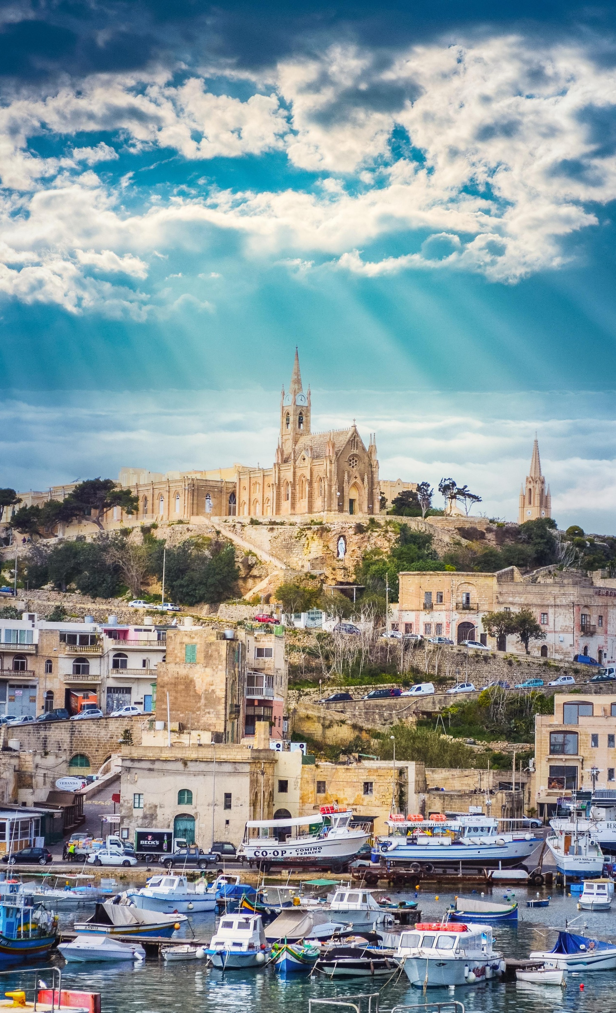
Types of sacred places in canon law

Slide 9
Types of sacred places in canon law
Churches (Chapter I)
Oratories and Private Chapels (Chapter II)
Shrines (Chapter III)
Altars (Chapter IV)
Cemeteries (Chapter V)
For our purpose, we will focus on churches, oratories, and altars.

Slide 10
Church: Definition
"By the term church is understood a sacred building designated for divine worship to which the faithful have the right of entry for the exercise, especially the public exercise, of divine worship" (c. 1214).
These also include cathedrals and parish churches. All faithful have the right to attend.

Slide 11
Church: what to know…
It needs the written consent of the diocesan bishop for a church to be built and he may only give his consent after hearing the presbyteral council and the rectors of the neighbouring churches (c. 1215 §§ 1-2).
In (re)construction of churches liturgical principles and norms are to be followed (c. 1216) and once (re)construction is complete, dedication/blessing needs to be done as soon as possible (c. 1217).
Once dedicated/blessed a church's title cannot be changed (c. 1218) and all acts of worship can be performed (c. 1219).
The preservation of cleanliness and installing necessary security are not to be forgotten (c. 1220).
Entrance in churches should remain free of charge during the time of sacred celebrations (c. 1221) and it is up to the diocesan bishop (and those concerned – such as – donors) to relegate a church to profane but not sordid use when he sees that a church can no longer be used for divine worship with no possibility of reparation (c. 1222).

Slide 12
Oratories: Definition
"By the term oratory is understood a place of divine worship designated by permission of the ordinary for the benefit of some community or group of the faithful who gather in it and to which other members of the faithful can also come with the consent of the competent superior" (c. 1223).

Slide 13
Oratory: what to know…
An oratory is sometimes called a 'chapel' in common discourse. It is different from a chapel because only a group of people usually have the right to make use of it (e.g. the elderly in a nursing home, staff and students in a school, etc).
Unless provided in particular law (i.e. diocesan regulations, policies, norms), the person in charge of the institution where the oratory is situated may permit others to have access to it (e.g. the head of the nursing home, the school principal of a school, etc.).
Any oratory (other than that found in the houses of religious institutes) need the permission of the local ordinary for the reservation of the Eucharist. Note that this permission is a separate permission from that that is required to establish the oratory. Beal et al., New Commentary…, 1433-1434.
Before granting permission for the establishment of an oratory, the ordinary must first visit the place destined to be an oratory (personally or through a delegate) and found the place properly prepared; an oratory cannot be converted to profane use without the authority of the same ordinary (c. 1224).
The liturgical books must be followed when it comes to the rite of blessing oratories (and private chapels). The blessing of oratories (and private chapels) is appropriate but not required. Regardless, however, they must be preserved for divine worship and free from all domestic uses (c. 1229).
Notes:
In response to c. 1225's '… except those which the law… excludes…":
Can. 932 §1. The eucharistic celebration is to be carried out in a sacred place unless in a particular case necessity requires otherwise; in such a case the celebration must be done in a decent place.
§2. The eucharistic sacrifice must be carried out on a dedicated or blessed altar; outside a sacred place a suitable table can be used, always with a cloth and a corporal.
Can. 530 The following functions are especially entrusted to a pastor:
1/ the administration of baptism;
2/ the administration of the sacrament of confirmation to those who are in danger of death, according to the norm of can. 883, n. 3;
3/ the administration of Viaticum and of the anointing of the sick, without prejudice to the prescript of can. 1003, §§2 and 3, and the imparting of the apostolic blessing;
4/ the assistance at marriages and the nuptial blessing;
5/ the performance of funeral rites;
6/ the blessing of the baptismal font at Easter time, the leading of processions outside the church, and solemn blessings outside the church;
7/ the more solemn eucharistic celebration on Sundays and holy days of obligation.
Can. 857 §1. Apart from a case of necessity, the proper place of baptism is a church or oratory.
§2. As a rule an adult is to be baptized in his or her parish church and an infant in the parish church of the parents unless a just cause suggests otherwise.
Can. 1118 §1. A marriage between Catholics or between a Catholic party and a non-Catholic baptized party is to be celebrated in a parish church. It can be celebrated in another church or oratory with the permission of the local ordinary or pastor.
§2. The local ordinary can permit a marriage to be celebrated in another suitable place.
§3. A marriage between a Catholic party and a non-baptized party can be celebrated in a church or in another suitable place.

Slide 14
Altars: Definition
"An altar, or a table upon which the eucharistic sacrifice is celebrated, is called fixed if it is so constructed that it adheres to the floor and thus cannot be moved; it is called movable if it can be removed.
It is desirable to have a fixed altar in every church, but a fixed or a movable altar in other places designated for sacred celebrations" (c. 1235).

Slide 15
Altars: what to know…
According to traditional practice, the altar is made of a single natural stone. However, any other worthy and solid material can also be used (in consultation with the conference of bishops). The support of base of the altar can be made of any material. On the other hand, a movable altar can be made of any solid material that is deemed suitable for liturgical use (c. 1236).
Fixed altars are to be dedicated, movable altars are to be blessed according to the norms of the liturgical books; relics (of martyrs and saints) can be placed under a fixed altar to be preserved (c. 1237).
Any acts that desecrate the place or cause scandal to the faithful as already mentioned through c. 1212 means that an altar loses its dedication or blessing (c. 1238). However, if a sacred place is relegated to profane use (c. 1222), the altar does not lose its dedication or blessing (c. 1238 §1), thus, a separate decree is required for its relegation.
On the other hand, a body cannot be buried underneath an altar, otherwise a Mass is not allowed to be celebrated on the altar (c. 1238 §2).

Slide 16
Altars: what to know…
According to traditional practice, the altar is made of a single natural stone. However, any other worthy and solid material can also be used (in consultation with the conference of bishops). The support of base of the altar can be made of any material. On the other hand, a movable altar can be made of any solid material that is deemed suitable for liturgical use (c. 1236).
Fixed altars are to be dedicated, movable altars are to be blessed according to the norms of the liturgical books; relics (of martyrs and saints) can be placed under a fixed altar to be preserved (c. 1237).
Any acts that desecrate the place or cause scandal to the faithful as already mentioned through c. 1212 means that an altar loses its dedication or blessing (c. 1238). However, if a sacred place is relegated to profane use (c. 1222), the altar does not lose its dedication or blessing (c. 1238 §1), thus, a separate decree is required for its relegation.
On the other hand, a body cannot be buried underneath an altar, otherwise a Mass is not allowed to be celebrated on the altar (c. 1238 §2).

Slide 17
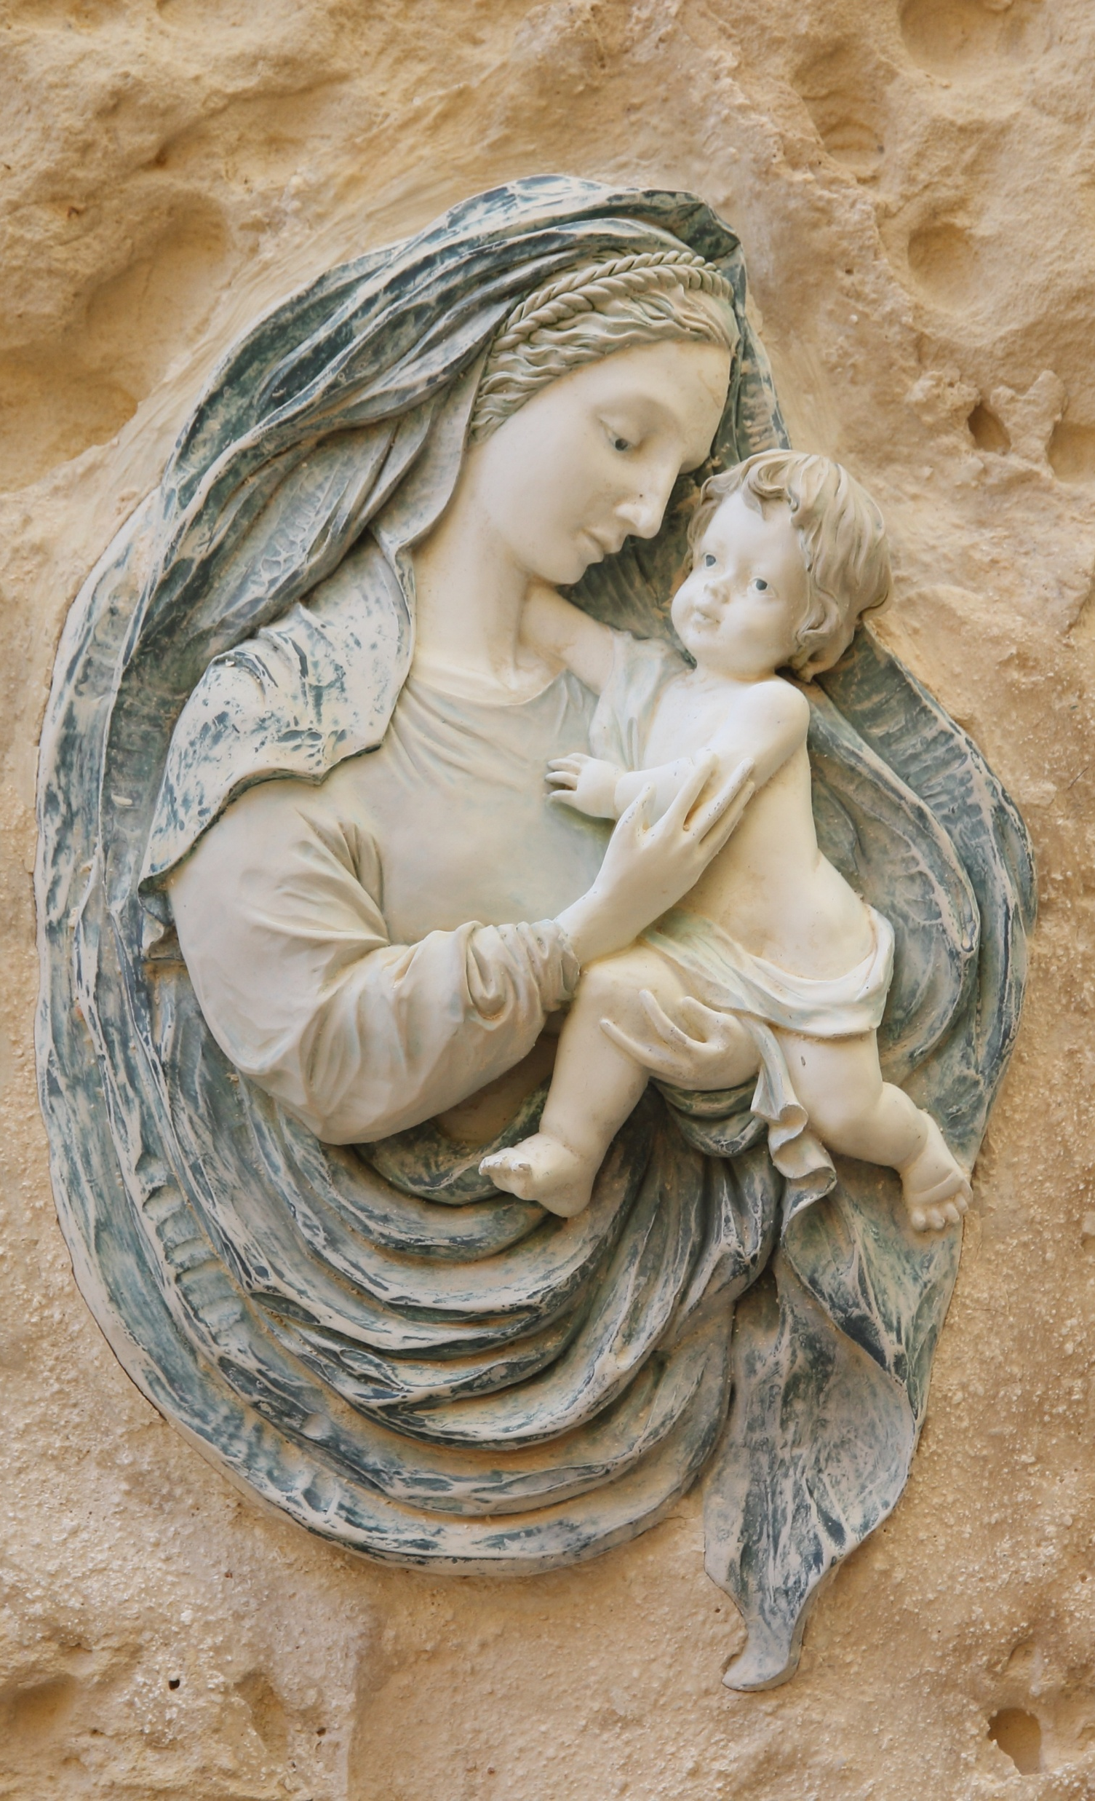
Comparing the Latin Code and the Eastern Code

Slide 18
The Latin Code and the Eastern Code:
A Comparison
Eastern Code (CCEO/1990) | Similarities | Latin Code (CIC/1983)
c. 868 | The definition of a sacred places: places for divine worship. | c. 1205
c. 869 | The definition of a church: for divine worship by consecration/blessing | c. 1214
c. 870 | The written consent is needed by the diocesan/eparchial bishop. | c. 1215 §1
c. 871 §§ 1-2 | The competent authority to consecrate/bless. Handling the document(s). | cc. 1206-1208
c. 872 §1 | Anything not consonant with the holiness/sanctity of the place is forbidden. | c. 1210
c. 872 §2 | The importance of cleanliness and security of a sacred place. | c. 1220 §1
c. 873 | Concerning relegation of a sacred place or its (re)(de)consecration. | c. 1222
Note: The equivalent for the diocesan bishop (CIC) is the eparchial bishop (CCEO). The ordinary is anyone in authority (e.g. religious superior in a monastery).

Slide 19
The Latin Code and the Eastern Code:
A Comparison
Eastern Code (CCEO/1990) | Differences | Latin Code (CIC/1983)
c. 874 §3 | The departed are not to be buried in churches… unless it was a high cleric. | c. 1242
c. 888 §§ 1-2 | Relics cannot be sold. Relics, icons or images (honoured with great veneration by the people) cannot alienated nor perpetually transferred to another church with the consent of the Apostolic See. Other canons must be observed when restoring icons or images. | c. 1190
Note: The CCEO includes these canons under the same category of sacred places while the CIC discusses veneration in general in the previous part of the same book (right before discussing sacred places).

Slide 20
The Latin Code and the Eastern Code:
A Comparison
The Latin Code focuses on the definition of the different types of sacred places, dedicating a special section solely on altars. It also puts a lot of focus on who has the authority to do what (e.g. establish, consecrate, bless and relegate).
The Eastern Code is more concentrated on the what sacred places are with particular focus put on churches (especially cathedrals, parish churches and churches attached to monasteries and religious houses).
Both codes put heavy emphasis on consecration and blessing and the importance of a sacred place's ultimate purpose of being a place of divine worship.
Both codes mention what needs to be done in case of deconsecration and how important it is to keep these places clean and secure.

Slide 21

Combining Sacred Places in Canon Law and ECSI

Slide 22
Combining (canon) law of sacred places with ECSI's Model 6 on sacred spaces
ECSI suggests a Catholic hermeneutical sacred space where a single Catholic sacred space welcomes a diverse school community.
In this one space, the school community may gather (regardless of their religion).
While everyone is welcome and everyone's identity is recognised, the Catholic members of the school actively participate in prayer and liturgy while non-Catholics can be 'respectfully present'.
In the school's sacred space everyone gets to encounter Catholicism, not forcefully but through hospitality. Christ is the unavoidable partner in this dialogue.
'Universal' (e.g. grape vine) and 'particular' (e.g. wine and the blood of Christ) symbols assist in smoothening this hospitality.

Slide 23
Combining (canon) law of sacred places with ECSI's Model 6 on sacred spaces
To be in coherence with canon law, it is suggested that the sacred space in a school is clearly and evidently Catholic. For instance, the Bible, a Crucifix/Cross, incense, candles, drapes coloured according to the liturgical calendar, among other things should be very well depicted. Although it is not always possible, and a parish priest needs to agree with it, a Tabernacle can also be added.
Since only Catholics (Latin/Eastern and some Christians) can participate in a Catholic sacred space, the others can indeed be present in a respectful way. They can read prayers (members, related to current world issues), they can pray within themselves and offer their intentions according to their own religion, etc.
The others cannot, for example, receive communion (in case there is a Eucharistic celebration), they cannot read the Gospel readings or take up the offerings.
The person carrying out the liturgical celebration or prayer (or an educator), must explain the Catholic symbolisms (especially where Confessionality is low) but also allow the present school community to reflect on other possible meanings, each according to their own life experiences, culture and faith. This person is there to assist in the formation of all the school members especially the Catholic ones.
Negative theology plays a part in this. For instance, while (Catholic) music can be used (e.g. Gregorian Chants), moments of silence can also be a way of encountering God.

Slide 24
Combining (canon) law of sacred places with ECSI's Model 6 on sacred spaces
We now know that canon law differs among different types of sacred places. It is highly probable that what we find in a school is an oratory (often referred to as a chapel). Ideally, all the information about the sacred place should be well-kept in the school files for future reference (e.g. when the school principal is replaced, the new one needs to know details such as whether the sacred place was actually consecrated/blessed).
As noted, canon law (CIC/1983) distinguishes between a sacred place and an altar. An altar requires a consecration/blessing on its own, which means a separate document must be present if an altar is present in a school. These documents are crucial in understanding how a sacred place was originally planned to be and perhaps what changed (e.g. was it ever relegated?).
Consequently, (although it happens often!) one cannot simply decide to transform a school oratory/chapel into a library or a kiosk without consulting the person that established it.
In case of specific needs or innovative ideas always consult with the ordinary or the diocesan bishop is necessary (or with the parish priest who should revert to his bishop for assistance).

Slide 25
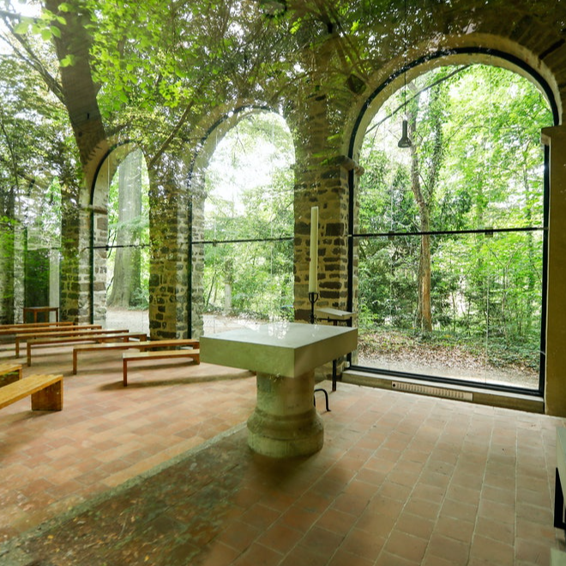
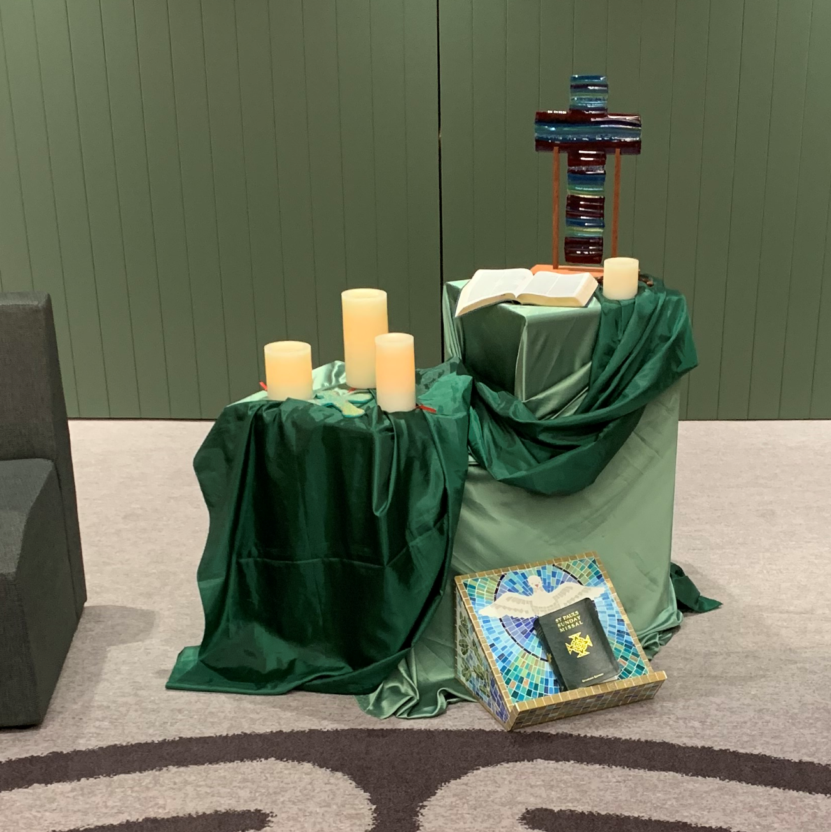
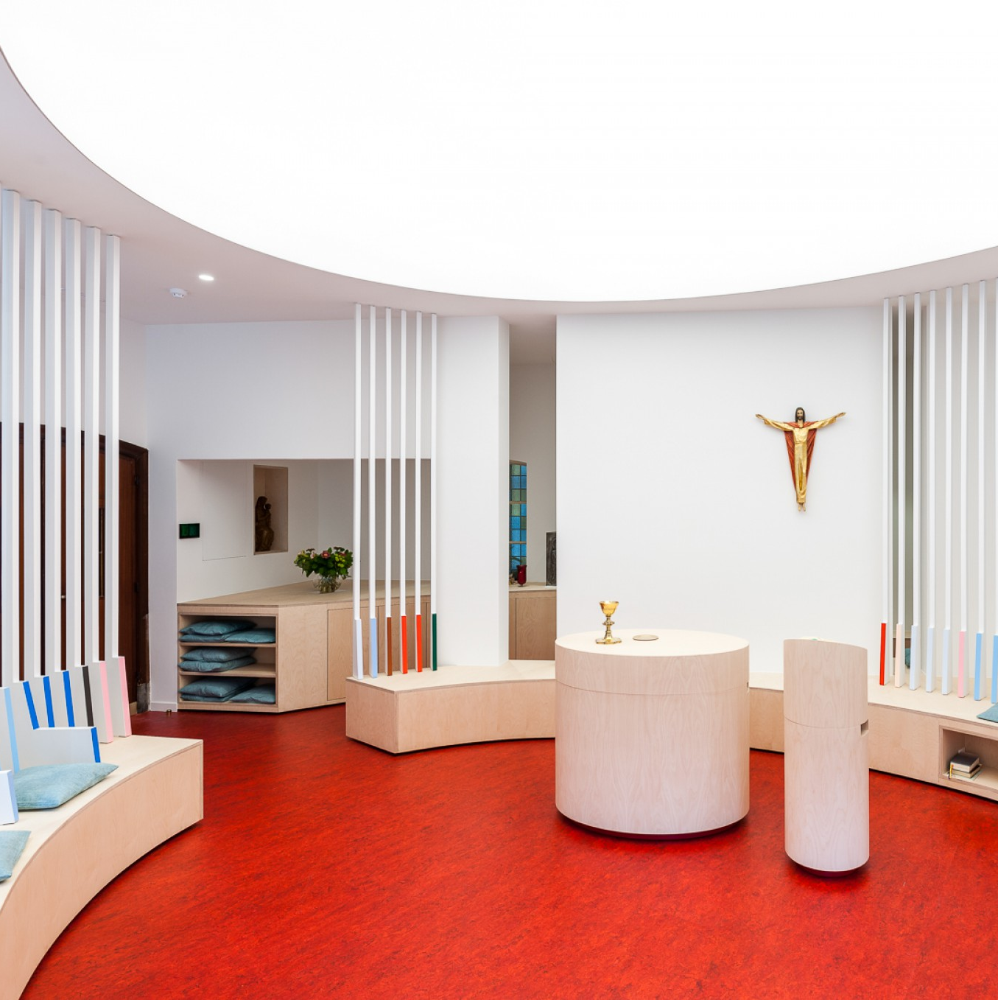
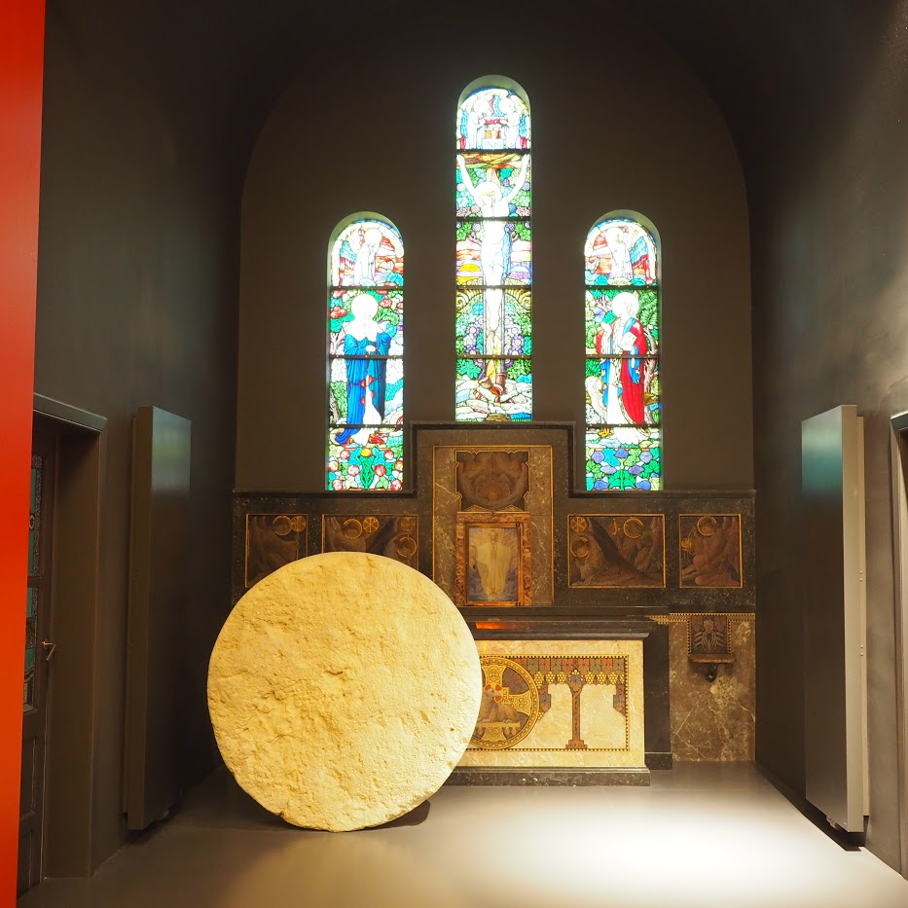
More Canonically Aligned Model 6 Examples
Catholic symbols that can be understood differently by others of different faiths are visible in these Catholic sacred spaces.
When someone enters these Catholic sacred spaces, they can easily distinguish them from a secular ‘sacred’ space, or a Jewish one or a Muslim one (or any other Christian one).
Each Catholic sacred space also reflects the place it is situated in (e.g. in a forest, in a hospital, in a school, etc.) and the country it is in with its respective Constitution and history (e.g. Belgium, Malta, the UK, India, etc.).
Notes:
A country might have Catholicism as the state religion (e.g. Malta) while others might have more than one recognised religion including Catholicism (e.g. Belgium). Others might also have declared a secular state while freedom of religion can also be exercised (e.g. India). The Constitution as well as the country’s religious and political history, play a role in the way a (Catholic) sacred space is organised and designed.

Slide 26

Frequently Asked Questions and
Concluding Remarks

Slide 27

FAQs – Part 1
1. Is a Catholic school required to have a dedicated sacred place, such as a church or oratory, as defined in canon law? Or is a sacred space, such as a multipurpose room arranged for adoration, prayer, or Mass, sufficient?
There is no obligation under universal canon law for a Catholic school to have a chapel or oratory. However, the school must provide religious education (c. 795). The mission of a Catholic school goes beyond liturgical celebrations; it involves the integral formation of the human person as per the Gospel values. The bishop is to be informed when a sacred space is created (c. 804 §1).
2. To what extent may non-Catholic students participate in the liturgy within a Catholic sacred space or place? For example, may they read the prayers of the faithful, join the choir, or contribute musically? Could a Jewish student read the same Old Testament narrative from the Torah?
Participation in Catholic liturgy must follow liturgical law. In interreligious settings, where people of different faiths offer their own prayers, there are fewer legal restrictions, though the Church continues to reflect on the theological implications of such events (cf. Directory for the Application of Principles and Norms on Ecumenism). The key question concerns the nature and direction of the prayer. For example, while interreligious prayer gatherings (such as those held in Assisi) have occurred, some theologians, such as Cardinal Ratzinger, expressed concerns about their appropriateness, particularly regarding the question: To whom is the prayer addressed?
3. Can the Eucharist be celebrated in a non-dedicated sacred space, such as a school hall, if a priest is present? Is it correct that the Blessed Sacrament may be brought to the school but not reserved there unless a tabernacle is installed?
The Eucharist should ordinarily be celebrated in a chapel or church. In exceptional circumstances, it may be permitted in another suitable space, provided the norms of the General Instruction of the Roman Missal are observed. The reservation of the Blessed Sacrament is only allowed in a properly designated sacred place, not in a temporary space. A tabernacle may not be installed in a non-dedicated location, and authorisation from the local ordinary (bishop) is required for the establishment of any private chapel.
Notes:
Question 1:
a. Directory for the Application of Principles and Norms on Ecumenism:
https://www.christianunity.va/content/unitacristiani/en/documenti/testo-in-inglese.html
Question 2:
a. General Instruction of the Roman Missal:
https://www.vatican.va/roman_curia/congregations/ccdds/documents/rc_con_ccdds_doc_20030317_ordinamento-messale_en.html
b. Sacrosanctum Concilium, 7:
"From this it follows that every liturgical celebration, because it is an action of Christ the priest and of His Body which is the Church, is a sacred action surpassing all others; no other action of the Church can equal its efficacy by the same title and to the same degree."
Question 3:
a. Bishop to be informed: c. 804 §1. The Catholic religious instruction and education which are imparted in any schools whatsoever or are provided through the various instruments of social communication are subject to the authority of the Church. It is for the conference of bishops to issue general norms about this field of action and for the diocesan bishop to regulate and watch over it.

Slide 28
FAQs – Part 2
4. Are activities such as Christian meditation, Bibliodrama, or focus groups permitted within a Catholic sacred place, such as a school chapel?
Such activities may be permitted as long as they align with the sacred character of the space. The use of a sacred place must comply with the relevant ecclesiastical regulations. The rector of the chapel or designated authority should determine whether a proposed activity is appropriate for the setting.
5. Can spaces such as classrooms, the school hall, garden, or gymnasium be used for the celebration of Mass with a temporary altar and the presence of a priest?
As explained in Question 3, the celebration of the Eucharist outside of a chapel or church is possible in exceptional circumstances, provided that liturgical norms are fully respected. Temporary spaces such as school halls, gardens, or gymnasiums may be used for Mass when properly arranged, with reverence and pastoral necessity.
6. Is the fundamental distinction between a chapel or oratory (a sacred place) and a sacred space that the former is defined and regulated by canon law, while the latter is not?
Yes, that is correct. A sacred place, such as a chapel or oratory, is formally dedicated or blessed according to canon law and is subject to specific regulations. For example, items within are consecrated and not to be removed or used for non-sacred purposes. Only baptised persons may fully participate in liturgical acts, while non-baptised individuals may be present or participate in limited ways. In contrast, the term sacred space is not defined in canon law and does not carry the same legal status or restrictions.
Notes:
Question 1:
a. Directory for the Application of Principles and Norms on Ecumenism:
https://www.christianunity.va/content/unitacristiani/en/documenti/testo-in-inglese.html
Question 2:
a. General Instruction of the Roman Missal:
https://www.vatican.va/roman_curia/congregations/ccdds/documents/rc_con_ccdds_doc_20030317_ordinamento-messale_en.html
b. Sacrosanctum Concilium, 7:
"From this it follows that every liturgical celebration, because it is an action of Christ the priest and of His Body which is the Church, is a sacred action surpassing all others; no other action of the Church can equal its efficacy by the same title and to the same degree."
Question 3:
a. Bishop to be informed: c. 804 §1. The Catholic religious instruction and education which are imparted in any schools whatsoever or are provided through the various instruments of social communication are subject to the authority of the Church. It is for the conference of bishops to issue general norms about this field of action and for the diocesan bishop to regulate and watch over it.

Slide 29
Remember!
For a sacred place (or sacred space) to be called such, it needs to be consecrated or blessed.
Once a Catholic sacred place is consecrated or blessed, the items inside it (except the altar if there is/will be one!) are also blessed. Consequently, it is crucial to make sure the place is complete inside and out before it is consecrated or blessed.
Once a Catholic sacred place is consecrated or blessed, the items inside cannot automatically be transferred and not all events inside it are allowed (e.g. an iftar!).
All prospective students (and their parents) are to be told explicitly before enrollment (so they have the chance to opt out before making any payments) that the school is a Catholic school and although they are not obliged to participate in Catholic events, they need to be at least present (most schools already mention this in a certain way).

Slide 30
Thank you for your attention!
Brenda Prato JCL

